Slide 1
Macroinvertebrates
Sample Research Presentation
Biology 101
Fall 2013

Slide 2
Macroinveretebrates – our focus
Macroinvertebrates are an essential ingredient in healthy streams, serving as an essential part of the stream’s food chain and reflecting the overall livability of the stream for all types of organisms.

Slide 3
What are macroinvertebrates?
An animal without a backbone, large enough to be seen with the naked eye.
Examples of macroinvertebrates include: crayfish, snails, clams, aquatic worms, leeches, and the larval and nymph stages of many insects, including dragonflies, mosquitoes, and mayflies.
“Macroinvertebrates are excellent indicators of water quality because they cannot move to a different section of water if the water they are in is uninhabitable.”
(“Vocabulary Catalog List Detail”)

Slide 4
Where do they live?
Macroinvertebrates live in streams, as an important part of the stream food web. These invertebrates feed on bacteria, fungi, algae, and partially decomposed leaves and provide food for predators.
(Rapp)

Slide 5
Types of macroinvertebrates
Sensitive to Pollution
Resilient in Pollution
Stonefly Nymph
Mayfly Nymph
Riffle Beatle Adult and Larva
Aquatic Worms
Left-handed Snail
Rat-tailed Maggot
(“Macroinvertebrate Identification Key”)

Slide 6
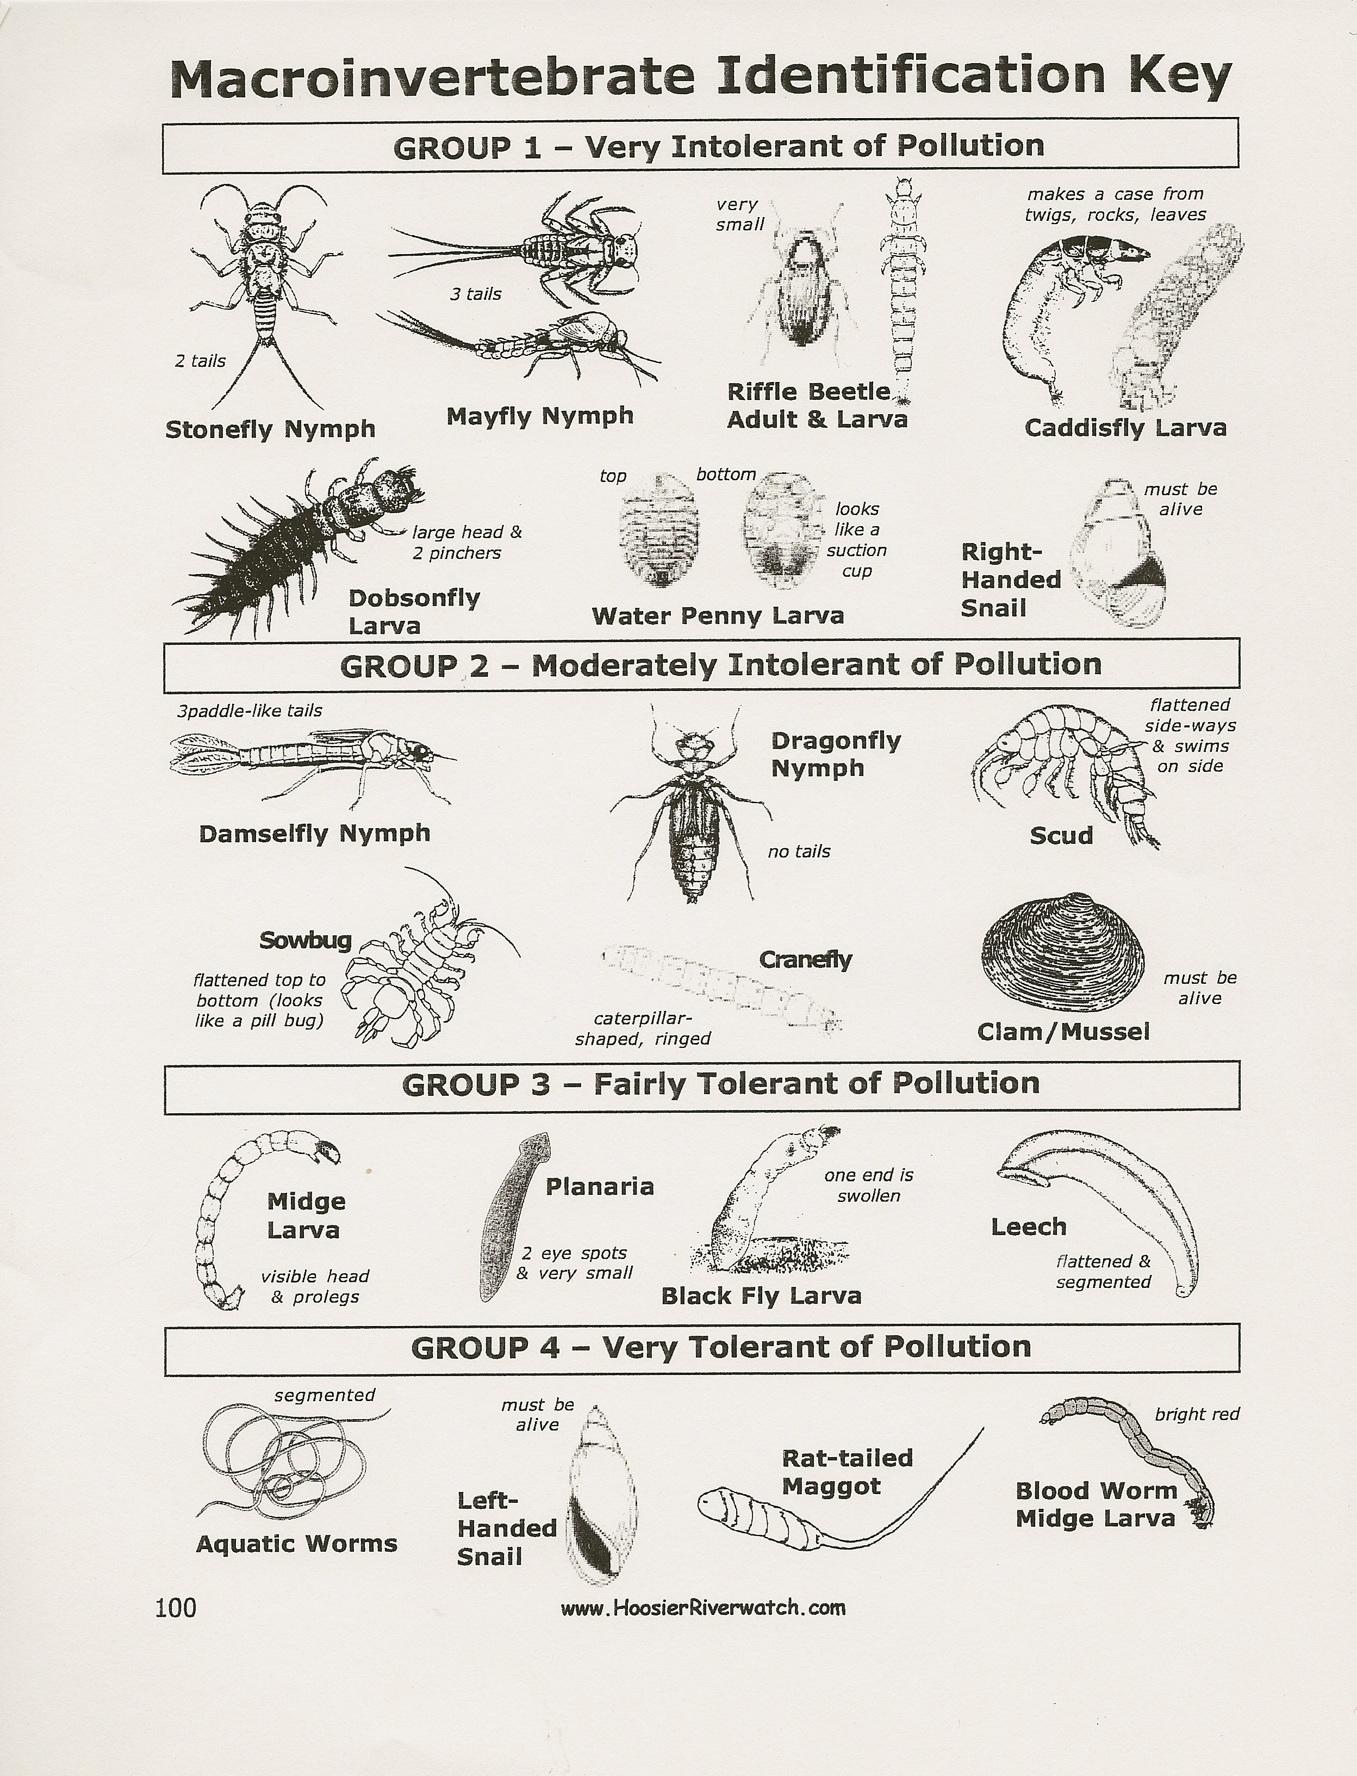
(“Macroinvertebrate Identification Key”)

Slide 7
Works Cited
“Macroinvertebrate Identification Key”. Digital image. Macd.org. Michigan Conservation Districts, n.d. Web. 21 Oct. 2013.
Rapp, Valerie. What the River Reveals: Understanding and Restoring Healthy Watersheds. Seattle, WA: Mountaineers, 1997. Print.
"Vocabulary Catalog List Detail - Lake Erie Lakewide Management Plan (LaMP) Glossary." EPA.gov. Region 5/Great Lakes National Program Office, 09 Dec. 2011. Web. 21 Oct. 2013.

